Slide 1

Neural Networks and Deep Learning
Eli Gutin
MIT 15.S60
(adapted from 2016 course by Iain Dunning)

Slide 2
Goals today
Go over basics of neural nets
Introduce TensorFlow
Introduce Deep Learning
Look at key applications
Practice coding in Python
Become familiar with Deep Reinforcement Learning (if time permits!)

Slide 3
Plan for today
Theory: Supervised learning & NNs Coding: classification problem
Theory: Unsupervised learning Coding: auto-encoder
Theory: Deep Learning
Coding: MNIST with ConvNets
Theory: Deep Reinforcement Learning

Slide 4
Supervised Learning and Neural Nets

Slide 5

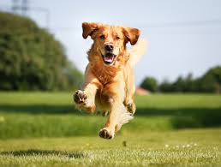
Motivation
Artificial intelligence…
Basic example: can the computer distinguish between cats and dogs?

Slide 6
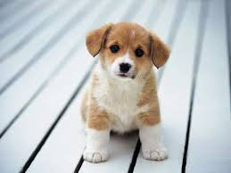
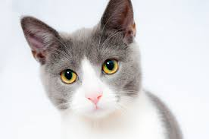
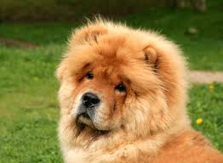
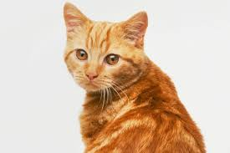
Supervised Learning
Dog=1
Cat=0
Cat=0
Dog=1
Dog=1
Now tell me: cat or dog?
Notes:
Quick intro to supervised learning
Algorithm given labeled images. Say a bunch of images of dogs and a bunch of images of cats…
Using these images the algorithm is trained to recognize new unseen images of cats or dogs. So when the algoirthm is fed a new image we hope that it produces the correct label
Setting very general. data could be almost anything: symptoms.. And the labels could be illnesses.
Or as we’ll see later .. Handwritten digits

Slide 7
Supervised Learning
Each image is 32x32=1024 pixels
3 channels: RGB
Input is a 1024*3 = 3072 dimensional space
Notes:
So let’s explain a bit more mathematically exactly what the algorithm is faced with in the images of cats and dogs example.
Each image is 32x32 pixels of 3 RGB channel values. So the space of images is a 3072 dimensional one and we can think of images as existing on a manifold in that space

Slide 8
Supervised Learning
Each image is 32x32=1024 pixels
3 channels: RGB
Input is a 1024*3 = 3072 dimensional space
Ground truth function if dog; else 0
Given training samples can we find ?
Notes:
We know there is some true mathematical function which given an image in the space we just talked about will output 1 if it’s a dog and 0 if it’s a cat.
So the concrete problem of supervised learning is given images (or equivalently data) and their corresponding labels we would like to find an algorithm that gives us a function f hat that reproduces f or is as close as possible to it.
So the next few hours are basically going to focus on ways of coming up with these training algorithms.

Slide 9
Perceptron: an early attempt
Activation function
Notes:
Well, let’s start by introducing one of the earliest training algo’s for supervised learning – the perceptron.
This basically outputs for us the following form for f hat. It’s an activation function of the dot product of wieghts w with the input x added to an offset b. The idea is that if the value of the dot product added to b is large enough above a theshsold , then the activation function will turn itself on and output 1 (in this case it’s WLOG that the threshold is zero).

Slide 10
Perceptron: an early attempt
Activation function
Need to tune and
x1
w1
…
w2
x2
σ
b
1
Notes:
So it will be helpful for the later parts of this lecture to visualize the perceptron as the following graph, the inputs are the nodes and the offset – also called the bias-- (or the pixels of the image), the edges have weights. The box represents sigma and later on it wil be helpfuil to think of this function, i.e. sigma applied to the dot product as a neuron and in this case the perceptron is a kind of single neuron learning algorithm. This all will be clear later.
To make the neuron effectively approximate the unknown function, we need to somehow tune the parameter vectors w and b using the training data.

Slide 11
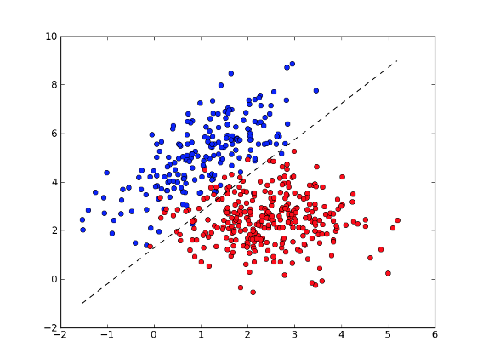
Perceptron: an early attempt
Notes:
Also geometrically the perceptron is a separating hyperplane. If we plot the images of cats and dogs in some and represent, say dogs, as the blue points and cats as the red ones then the perceptron is a hyperplane that tries to separate the training data as best as possible.

Slide 12
Perceptron: an early attempt
“Tune w and b
so that the approximation is accurate”
Notes:
By tuning w and b we change the slope and position of this hyperplane.

Slide 13
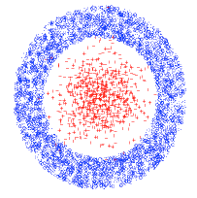
Main issue with Perceptron
Ground truth may simply not be linear
Need to generalize the Perceptron idea
Notes:
So what’s one of the biggest problems with the perceptron? Well the data may simply not be linearly separable and take these circular shapes as an extreme example. In this case the single perceptron will be a bad classifier and we need to somehow generalize the idea to come up with more powerful approximation architectures.

Slide 14
Multilayer perceptron
1
w_{1A}
w_{1B}
2
A
w_{1C}
3
A neuron is of the form 1(w.x + b > 0)
We can call the box a “neuron”
Notes:
So remember that the single perceptron looks like this. It’s neuron function of some the input plus an offset.. Or we can write it compactly as the indicator function of the wx + b being greater than zero. So let’s now give what’s known as a multilayer perceptron, or a feedforward neural network.

Slide 15
Multilayer perceptron
w_{1A}
A
1
w_{AE}
w_{2B}
B
2
E
C
3
w_{DE}
w_{1D}
D
A neuron is of the form 1(w.x + b > 0)
We just added a neuron layer!
Notes:
The first thing we can do is instead of having one neuron, we can compose several of these neurons together. In this diagram we have 5 neurons, 4 are connected to the input and their outputs feed into one neuron. We can refer to the first set of 4 neurons as the first layer and the last final neuron as being a second layer. It’s common in the field of neural netwroks to talk about the input nodes as a visible input (layer), the 4 neurons as the first hidden layer, and the last neuron as the 2nd hiden layer, with the output node being its own layer as well.
So the key point is that instead of having a single neuron and single layer, like we did with perceptron, we now have 2 layers and it’s hopefulyl not hard to see how we can generalzie this to n layers.

Slide 16
Multilayer perceptron
w_{1A}
A
1
w_{AE}
w_{2B}
B
2
E
C
3
w_{DE}
w_{1D}
D
A neuron is of the form σ(w.x + b) where σ is an activation function
We just added a neuron layer!
We just introduced non-linearity!
Notes:
Finally, there is also no reason we have to stick to an indicator function as the activatiuon function, we can generalzie this to be anything.

Slide 17
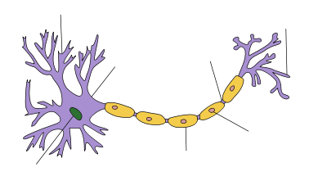
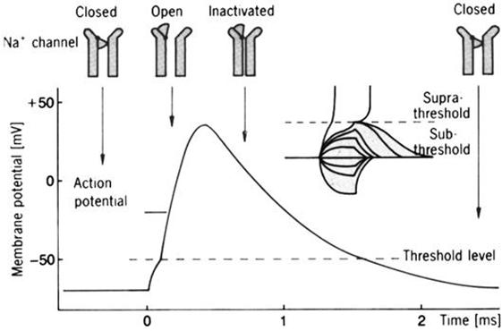
The idea of activation function
Hodgkin-Huxley model simulates biology
Notes:
Except for the activation function to make sense it should something that’s increasing .. Much like the biological neuron would give off an electrical signal which is the larger the more stimulation from other neurons it receives.
The HH model is an attempt to model this phenomenon. The longer a neuron is exposed to input signal the more its potential increases in millivolts and then eventually dies down.

Slide 18
Ways to choose activation function
STEP FUNCTION
Used in good old-fashioned perceptron
Notes:
Don’t need to use something as complicated as HH model. In fact, the most common choices of activation function are these three. is the logistic function which is smooth and differentiable and so is a bit like HH. ReLu is a piecewise linear function (basically the positiver part) which is cheap to compute and shown to be really effective in deep learning. There is also the ultra-simple linear activation function (basically identity function) which is restricted to the final layer, otherwise it’s a bit too simple.

Slide 19
Ways to choose activation function
LINEAR
like linear regression
(only used for final layer)
LOGISTIC / SIGMOIDAL / TANH
Smooth, differentiable, saturating functions
RECTIFIED LINEAR (ReLU)
Cheap to compute, popular lately
Notes:
Don’t need to use something as complicated as HH model. In fact, the most common choices of activation function are these three. is the logistic function which is smooth and differentiable and so is a bit like HH. ReLu is a piecewise linear function (basically the positiver part) which is cheap to compute and shown to be really effective in deep learning. There is also the ultra-simple linear activation function (basically identity function) which is restricted to the final layer, otherwise it’s a bit too simple.

Slide 20
Final generalization for MLP
Output can be multi-dimensional
Notes:
Finally it’s worth mentioning that the output layer of a neural network doesn’t have to be a single neuron, it could be a number of them. In fact we will see this a lot in deep learning where the output is a bunch of neurons representing a probability distribution over labels.

Slide 21
Universal approximation theorem
Theorem: 2-layer NNs with sigmoid activation functions can approximate any other function
(Kurt Hornik: Approximation Capabilities of MultiLayer FeedForward Networks, 1991)
Notes:
One fundamental property of neural networks is that by having just 2 layers, and having many neurons it’s possible to reproduce any function in some class, I think it’s smooth continuous functions. Of course there are some conditions for the theorem to hold but despite this result, in practice it’s found that actually having many layers is what makes a NN effective.

Slide 22
How do we optimize the neural net’s parameters?
Quantify how bad the current net is via loss function
Notes:
Training the neural network is done in much the same way as any other machine learning algorithm
The ocnvention is to somehow quantify how bad the network’s current performance is on the traning data. And one measure of this is a loss function

Slide 23
How do we optimize the neural net’s parameters?
Quantify how bad the current net is via loss function
Training data is . Parameters
Loss function is
E.g. square loss
Notes:
So we have the training data as a bunch a pair of vectors x, y. Imagine the parameters to tune are w, the predictive function is f. One example of a loss function is taking the difference between what f hat predicts and the actual labels y .. and taking the sum of their sqaure differences, this is the square loss.

Slide 24
How do we optimize the neural net’s parameters?
Quantify how bad the current net is via loss function
Training data is . Parameters
Loss function is
E.g. square loss
Need to minimize the loss function
Notes:
Once the loss function is defined, we have a concrete optimization problem in terms of w, the wieghts in the neural network, as the variables.

Slide 25
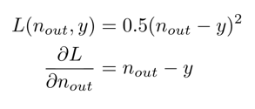
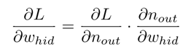
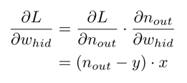
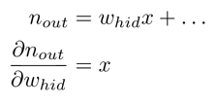
Backpropagation algorithm
f
f
f
w_{inp}
n_{hid}
w_{hid}
n_{out}
Chain rule!
Notes:
Backpropagation is an implementation of SGD
- reduces error by moving the weights in the negative direction of their gradients
- does this by computing the ouput of the net, and hence the error with each training example
- the algorithm basically works as follows
- for every training example, it does a forward pass where it propagates neuron outputs layer by layer. Once the error can be computed it computes the gradients of all wieghts in a backward pass.
- the backward pass works using the chain rule and here is an example
-we want to compute the gradient of the hidden layer wieght
- we use the chain rule then compute each of the two gradients and combine them

Slide 26
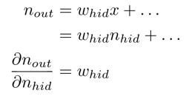
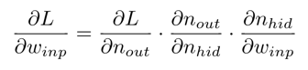
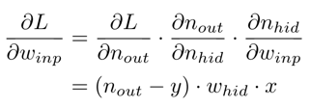
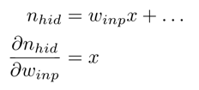
Backpropagation algorithm
f
f
f
w_{inp}
n_{hid}
w_{hid}
n_{out}
Notes:
Going backwards for the outer layer, we use the error from the layer in the previous slide to compute its gradient
Once all gradients are found we are able to reduce the error in the net by adjusting the weights using SGD.

Slide 27
Notes on backpropagation
Can calculate derivatives automatically
Opportunities for parallelism
Re-using intermediate values and other efficiencies
Painful DIY - if only there was a framework...
Notes:
TensorFlow can figure out what computations can be run in parallel and schedules them on several CPUs or GPGPUs if your machine has them.
All these optimizations can be performed when the user describes a graph of operations..
Implementing this all yourself is very tricky

Slide 28
Implementing Neural Nets with TensorFlow

Slide 29





Frameworks for Implementing Neural Networks
Notes:
There are a couple of different frameworks for impelemtning neural nets
TensorFlow is the one will look at.

Slide 30
Today: Google TensorFlow
Use TF to describe computations as a graph
TF schedules computations on devices - CPU, GPU...
Performs automatic differentiation (like JuMP!)
Python is easy to use
Notes:
It’s actually pretty general library for numerical computation.
Using tensorflow u can describe computation graphs. Each node in the graph is a mathematical operation and each edge is multi-dimensional array, also known as a tensor.

Slide 31
Project 1 - Nonlinear classification
Goal: approximate an unknown non-linear classifier from data
Plan: generate data, create ANN, fit it
Live coding in IPython - follow along!
Play with extending the code
Notes:
Fit a non-linear classififer to a sphere using randomly generated data
We’ll be using Ipython

Slide 32
Project 1: Non-linear classification
f
f
Y
f
f
N
f
INPUT
HIDDEN LAYER
SOFTMAX OUTPUT LAYER
OUTPUT

Slide 33
Project 1: softmax layer
Generalization of logistic function
Squashes a bunch of arbitrarily real numbers into a prob. distribution
Think of this as yet another activation function

Slide 34
Project 1: cross-entropy loss
Since we’re comparing a prob. distribution to true 1-hot encoding, we’ll use the cross-entropy function as the loss:

Slide 35
Project 1: extensions
Try changing…
the number of training points
the number of hidden neurons
the input layer activation function
Gradient Descent’s learning rate
the optimization algorithm
etc.

Slide 36
Unsupervised learning & data representation
http://www.mit.edu/~9.520/fall16/Classes/ldr.html

Slide 37
Successful ML ingredients
Learning algorithms
Lots of labeled data
Computational power

Slide 38
Successful ML ingredients
Learning algorithms
Lots of labeled(!!) data
Computational power

Slide 39
Why unsupervised?
Labeled data is expensive to get
Unlabeled data cheaper / widely available
Different goals:
Cluster analysis
Embedding data in new vector spaces
Compression…
Finding good representations can improve Supervised Learning

Slide 40
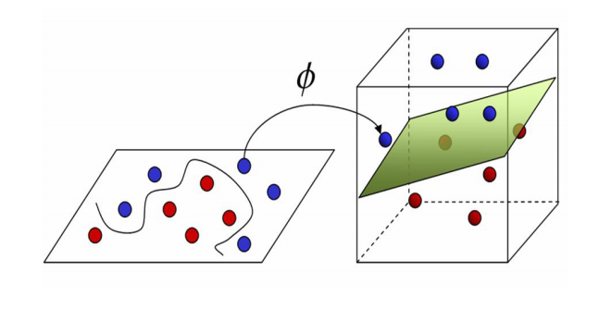
Why unsupervised?
Finding good representations can improve Supervised Learning

Slide 41
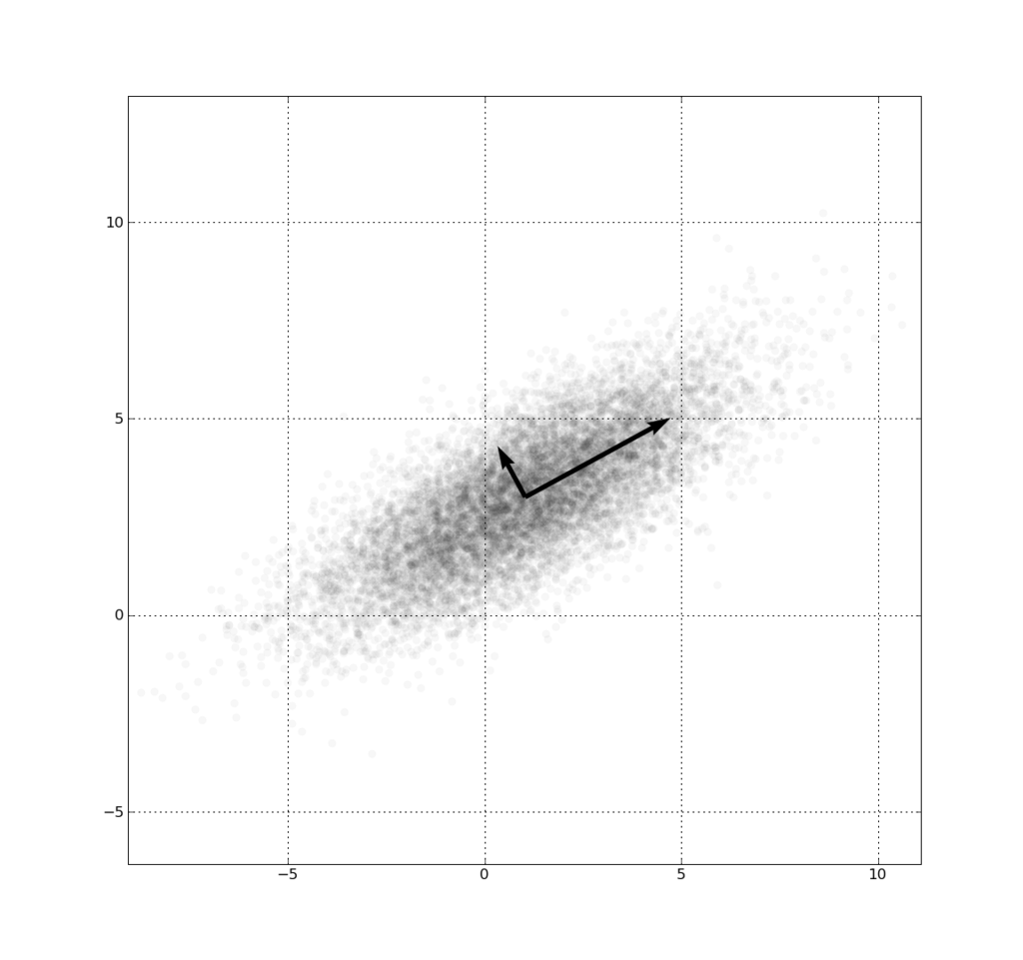
Example: autoencoders
Images are high-dimensional vectors
Hypothesis: can project high-dimensional vectors into low-dimension without much loss
PCA is a classic way of doing this
Can also use ANN!
Notes:
We’re going to introduce the idea of learning features in things like image data
The basic idea is that high-dimnesional data can be more easily represented in a lower dimensional space.
Benefit of dim. reduction is that there is less noise in the variables, so the machine learning algorithm couldbe less liable to overfit
PCA is a fundamnetal way to achieve dimensionaliy reduction
Find principal directions in the data
And project all points onto this principale direction (or also known as component)
Artificial neural networks can be used to achieve the same goal
The unsurpevized (that is lacking any labels) learning of codes in data

Slide 42
ERROR = f(INPUT - OUTPUT)
ENCODE
DECODE
f
f
f
f
f
f
HIDDEN LAYER
HIDDEN LAYER
OUTPUT
INPUT
CODE
Notes:
- Talk about autoencoders
It’s a multilayer feedforward NN just as before having multiple hidden layers.
However what’s special about them is that there is a layer in the middle known as the ‘code’ and it’s meant to be a lower-dimensional representation of the data
There are hidden layers in the net used for encoding the data into the code and other hidden layers further down the network for decoding the code into the original data
Since we want essentially a lossless compression, whenever the autoencoder is trained the goal is present it data and tune the wiehgts in such a way as the reproduced data coming from the output of the autoencoder is as close as possible to what’s passed in as the input
Purpose of output layer is to reconstruct the input

Slide 43
Project 2 – “learn” binary?
Consider “one-hot” vectors for the numbers 1 to 8
[1,0,0,0,0,0,0,0] [0,1,0,0,0,0,0,0] [0,0,1,0,0,0,0,0] …
Can represent these vectors in 3D, e.g.
[0,0,0] [0,0,1] [0,1,0] [0,1,1] [1,0,0] [1,0,1] [1,1,0] [1,1,1]
Can a neural network learn that?
Concept from: https://blog.wtf.sg/2014/05/10/recursive-auto-encoders-an-introduction/
Notes:
In this next project, we’re going to try consider as our data simply the numbers 1 through 8. They will be represented in a one-hot code form, that is the number 1 is
Our goal is try and see if a neural network can compress these numbers into a 3D representation. Obviously we know that this can be done thanks to binary

Slide 44
Project 2 – “learn” binary?
1
ENCODER
DECODER
2
3
...
Concept from: https://blog.wtf.sg/2014/05/10/recursive-auto-encoders-an-introduction/
Notes:
So let’s see we have an encoder decoder pair that take in the number 1 through 8 and reconstruct those same number in the end.
We hope that the layer in the middle will figure out binary codes
Here is a graph of the basic architecure

Slide 45
Project 2 - Assignments - Try...
… changing the activation functions
... using fewer hidden units - what can you recover?
... using multiple layers
… using different weight for encoding and decoding or adding biases

Slide 46
Recent work on representations: word2vec
Given a text corpus, embed words in n-dimensional space
“Similar” words should be “close” in this space
Use a (fairly simple) neural network to encode
Results are…
Paper: http://arxiv.org/pdf/1301.3781.pdf
TensorFlow example: https://www.tensorflow.org/versions/master/tutorials/word2vec/index.html
Notes:
-https://www.tensorflow.org/versions/master/tutorials/word2vec/
Explain what natural language processing is exactly
Just explain vaguely what that paper is about

Slide 47
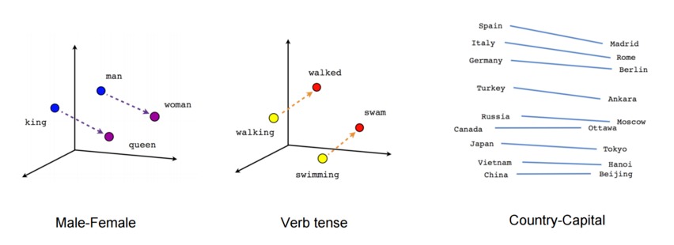
PARIS - FRANCE + ITALY = ROME
JAPAN - SUSHI + GERMANY = BRATWURST
BIG - BIGGER + COLD = COLDER

Slide 48
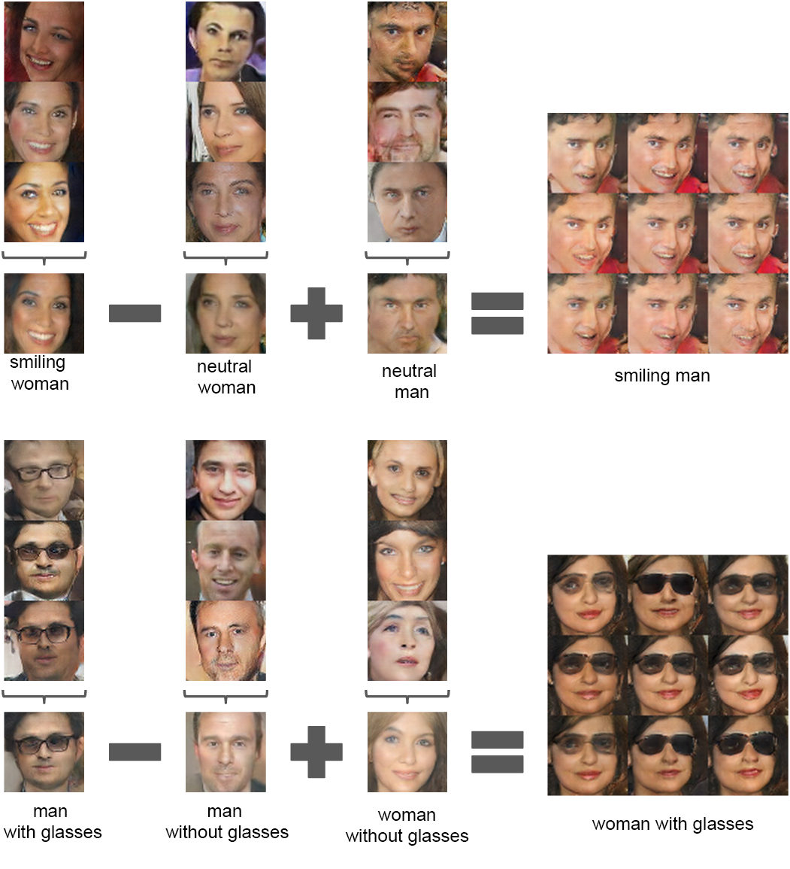
“Unsupervised Representation Learning with Deep Convolutional Generative Adversarial Networks”
https://github.com/Newmu/dcgan_code
Notes:
-arithmetic operations on faces
- Learning representations in a completely unsupervised fashion

Slide 49
Deep Learning with ConvNets
Based on:
https://adeshpande3.github.io/adeshpande3.github.io/A-Beginner's-Guide-To-Understanding-Convolutional-Neural-Networks/

Slide 50
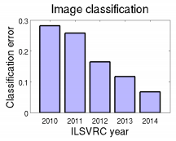
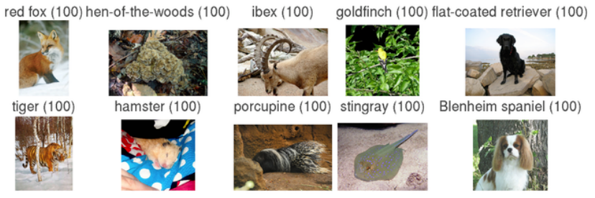
ImageNet Classification Challenge (annual)
More info: http://arxiv.org/abs/1409.0575
1000 object classes, Approximately 1.2 million training, 50k validation, and 100k test images.
Big improvements: 28.2% error rate to 6.7% error rate - human level! How? CNNs!
Notes:
2012 was the first year that neural nets grew to prominence as Alex Krizhevsky used them to win that year’s ImageNet competition (basically, the annual Olympics of computer vision), dropping the classification error record from 26% to 15%

Slide 51
Deep Learning for image processing
Back to cats and dogs…
Input dimension is ~200k (256*256*3)!!
Challenges:
computationally intensive
questionable performance with shallow architectures…
..would require astronomical amount of data
Notes:
So we’re going to focus today on a particular kind of deep learning. That is, using convolutional neural nets
Gonna focus on image processing – how to use cnns for image classifcation

Slide 52
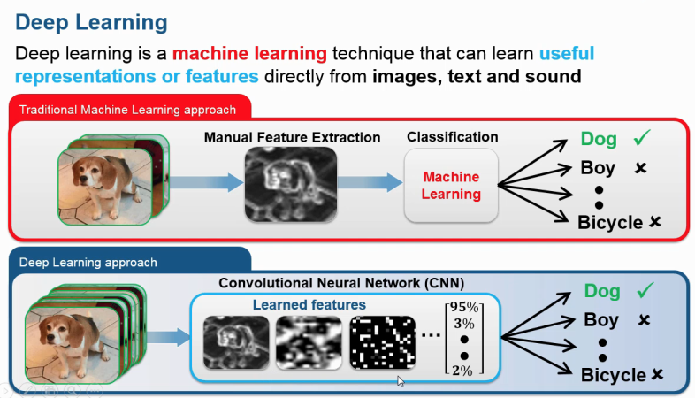
What is deep learning?
Set of algorithms that learn data representation
We focus today on ConvNets
Learning represenation and training classifier at the same time is the novelty with Deep Learning!
“It’s not that SVMs are bad”

Slide 53
Basic ingredients of ConvNets
Lots of layers... more usually perform better!
Most commonly used:
Fully Connected Layers (MLPs - already covered today)
Convolution
Pooling
Dropout
Others: batch norm, ReLU, etc.
Notes:
Take inspiration for building neural nets - How do humans recognize cats or dogs?
Cerebral cortex works as follows
First look for low level features (or low-level details) in an image such as the presence of curves or edges & their orientations
The presence of these features makes certai ngroups of neurons fire in the brain
These then pass on their signals to neurons further down which then assemble the low level features into more abstract concepts
These stages of processing are the layers in the artificial neural network
Each layer can be thought of as belonging to one of 4 different types. The first is the one we’ve seen before a layer in the neural net can just be a bunch of connections to all neurons in the next layer with the corresponding activation function.
Then there are 3 new ones that we will discuss today

Slide 54
Convolution
...
INPUT MATRIX
FILTER
OUTPUT
MATRIX
Notes:
Convolution relies on something called a filter. You should think of a filter as just different image, or a matrix of pixel intensities.
What happens is the filter is like a function that is applied to different parts of the images.
So let’s start by imagining we have this 3x3 matrix, the filter, and it’s now being applied to the top-left 3x3 pixels in the image (we call this smaller area of the image, the receptive field), so the top left corner of the smiley face. We then take a dot product of the filter matrix (which you can think of as just a vector of numbers) with the receptive field, the sub-region in the original image. The result of the dot product is a single number and it gets stored into an output matrix, in this case since we convolved or took the dot product with the very topleft of the image, the result is toired in the top-left single pixel of the output matrix. You keep repeating this dot product operation with the filter around different parts of the image. The way the filter typically moves is it first scans a row by moving 1 position to the right each time, once it’s donw with that row it then moves the next one and slides across one pixel at a time to the right.
Since we’re not using any padding and the original image is 8x8, the resulting image is 6x6

Slide 55
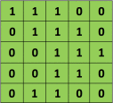
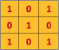
Convolution
Image
Filter
Notes:
Another way to think of the filter as some kind of colored flashlight that shines on different areas of the image. Each time the flighshlight shines what you see is the dot product of the pixels, then what you see from the flashlight is recorded in every position of the image and the complete recording is called the convolution.
Let’s just finally see what’s going on with the following animation. So here for simplicity, we just have an image with binary pixel values and the filter is again , think of it as another image, consisting of just 0s and 1s.
The filter moves across the image, the recording of the dot products we’ll refer to as the feature map.

Slide 56

Convolution
Image
Filter
Notes:
Imagine flashlight that shines over the top left of the image and then can move across it. Let’s say it covers a 3x3 area, this area is called the receptive field of the image
Light from flashlight is called a filter, think of it as simply another image or matrix of pixel intensities
As the flashlight moves imagine that what you see is simply the dot product of the filter and the

Slide 57
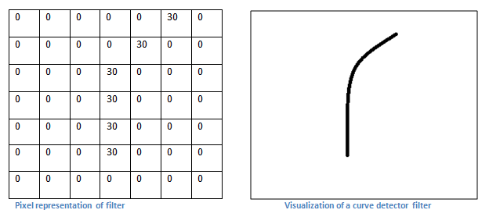
Convolution – The intuition
Notes:
So this seems a bit arbitrary so let’s try to understand why convolution is helpful.
Convolution helps us to flag salient parts of an image. Like imagine our filter is like the detector for a curve shape, so it will have pixel values of the above matrix,

Slide 58
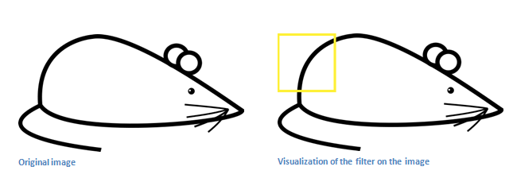
Convolution – the intuition
Recall the curve detector
Output matrix will have a large value here!
Notes:
So let’s suppose we have a mouse image. Our curve detector when applied to the yellow square in the image will produce a dot product of the 2 corresponding matrices, the receptive field in the image and our filter. Because the black areas, or high values algin, the convolved output image will have a large value in that location.

Slide 59
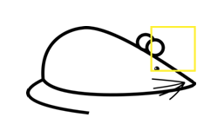
Convolution – the intuition
Conversely, the output matrix will have a
zero value here!
Notes:
However, if we move our curve detector into a different location – say the head of the mouse, then because none of the non-zero values from the two matrices align, the dot product will be zero. So the filter gives us a grayscale which is darker in parts of the original image where there are things like look like curves.

Slide 60
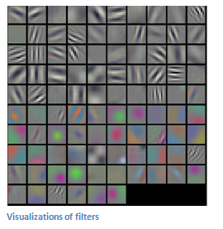
Convolution - summary
Different filters (each acting as a feature detector) produce a feature map
Shallow layers detect low-level features
Deeper layers learn more complicated features
Notes:
Imagine several layers of convolutions stacked on top of each other. In each layer you can apply multiple filters at the same time, doersn’t just have to be a single curve detector. Could be a fixed number, say 10 detectors, of different shapes, curves, and edges.
The earlier layers look for simple shapes, or low-level features and the later layters in the convnet, close to the output layer will assemble these basic shapes into more complicated images or representations of the input space. The kind of logic you would get is that if you detect a lot of whiskers and paws then the image is very likely to be a cat. This is more powerful obviously than having a single fully connected layer that has to discrimnate between cats and dogs based on just the raw pixel values given as they are. Better to break down the problem like I described.
Obviously we don’t know what the filters should be in advance, so just like we can train the weights between neurons in an old-fashiend multi-layer perceptron, for a given architecture or number of filters we can learn what each of those filtersshould be so that the resulting series of layers will give us a classifier that’s as accurate as possible.
For example, this image here is a visualization of the 96 different filters in the first layer of a trained convolutional neural network.

Slide 61
Pooling layers in CNN, deep structures
Maybe a filter learns to detect eyes
Precise location of eye is maybe unimportant
Use a pooling layer to downsample
CONVOLUTION
OUTPUT
2x2 MAX
POOL
POOLING
OUTPUT
Notes:
As mentioend before there are other types of layers in a convnet. These would be interespered between the convolutional ones.
SO here’s one of them – pooling layer. What this does is conceptually similar to a filter. The idea is that you split up the image horizontally and vertically into non-overlapping subsections. Like in this diagram we have some convolutional output and we split it up into 2x2 sections. In each section, you take the pixel with either the largest or smallest value and throw away the others. You end up with essentially an image which is half or a fraction of the size.
Reason for downsampling like this is dimensionality reduction to improve efficiency and also by filtering out potentially noisy elements in an image you’re less likely, when training the convnet to overfit.

Slide 62
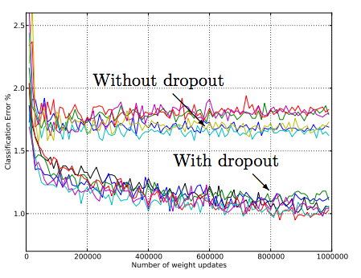
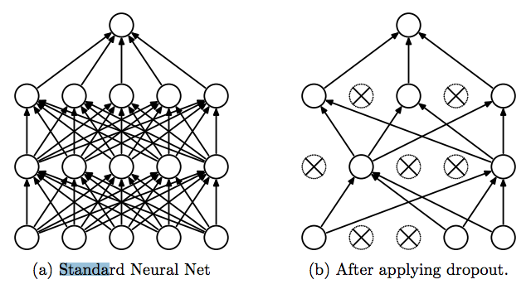
Dropout - cheap regularization for ANN
http://jmlr.org/papers/volume15/srivastava14a/srivastava14a.pdf
Notes:
Here is a final way and very recent way to combat overfitting. This is now a common technique in convnets.

Slide 63
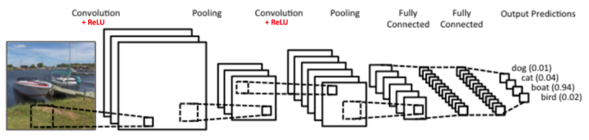
Early ConvNet: “LeNet-5”
http://deeplearning.net/tutorial/lenet.html
Notes:
What a complete convnet would look like…
You have your input image and you apply convolution to it using 3 filters. For each image you can think of this as generating 3 convolved images with a ReLU activartion function appleid immediately after the convolution.
The 3 convoled images are then downsampled with the pooling layer to give 3 smaller images.
Then you convolve the 3 hidden layer images together (meaning you take the dot product of the filter and the sum of the images), do this with 6 different filters and end up with another hidden layer of 6 convoled images. Each fo those is then finally downsampled once more and then the outputs of those travel through 2 more fully connected layers (just a multilayer perceptron) and finally there is a softmax activation function applied at the end which give the class probabilities.

Slide 64
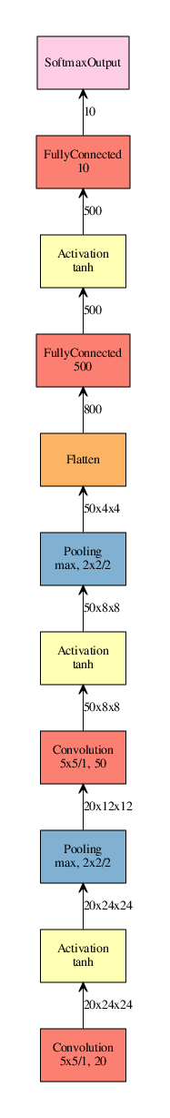
“LeNet”
1998:
“AlexNet”
2012:
“GoogLeNet”
2014:
“Inception v3”
2015:
Source: http://josephpcohen.com/w/visualizing-cnn-architectures-side-by-side-with-mxnet/
Notes:
On the left is what I described

Slide 65
Project 3 - MNIST Digit Recognition
Classify hand-written images of digits 0 to 9
Classic “MNIST” data set used widely in ML research
Will use convolutional neural networks!

Slide 66
Project 3 - Assignments - Try...
… changing the filter sizes, max pool size
... adding or removing layers
... using SGD
… varying the amount of dropout (with iteration?)
… varying the batch size

